Slide 1
Consumption and Needs

Slide 2
Cartoon Analysis:
1. Description:
- What can we see?
2. Analysis:
- What is the topic?
- What is the problem described?
- How does the artist express it?
3. Evaluation:
- Your opinion on the cartoon.
- Do you agree/disagree and why?
Source: https://www.polyp.org.uk/images/cartoons/RatRaceEnglish.jpg

Slide 3
Group Work
Get together in groups.
Assign one person to take notes on your discussion.
Discuss what needs a human may have that need to be fulfilled.
Be prepared to share your findings with your classmates.

Slide 4
Abraham Maslow
Born 1908 in Brooklyn, New York.
Jewish immigrants from Kiev (Russian Empire).
Struggled against racism and ethnic prejudice .
Pursued an academic career into psychology.
Through his experiences and inspired by the humanistic psychology, he created A Theory Of Human Motivation.

Slide 5
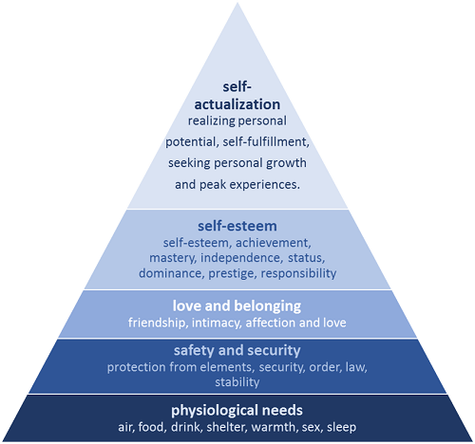
Source: https://commons.wikimedia.org/wiki/File:Maslows_hierarchy.png

Slide 6
Is Maslow‘s Pyramid a hoax?
“So far, our theoretical discussion may have given the impression that these five sets of needs are somehow in a step-wise, all-or-none relationships to each other. We have spoken in such terms as the following: “ If one need is satisfied, then another emerges.” This statement might give the false impression that a need must be satisfied 100 per cent before the next need emerges. In actual fact, most members of our society who are normal, are partially satisfied in all their basic needs and partially unsatisfied in all their basic needs at the same time. A more realistic description of the hierarchy would be in terms of decreasing percentages of satisfaction as we go up the hierarchy of prepotency.” (A Theory Of Human Motivation P.388)
Hoax: Widely publicized falsehood

Slide 7
Task:
Take another look at the pyramid. We assume that all needs will always be satisfied partially in modern society. Out of the five needs introduced by Maslow, pick one that you think should be at the bottom of it as most important need. Write a short text (5-7 sentences) that justifies your decision.

